Slide 1
ECF SHARED LIBRARY
ECF Next and ecf content access usage with ecf shared library

Slide 2
Agenda – Page 1
Will not talk about creating Angular Libraries in Detail
See this tutorial: Pluralsight(2 hours long if you watch the whole tutorial; certain modules or tutorials are not important, so could be less than 2 hours for some developers) – https://app.pluralsight.com/library/courses/structuring-angular-applications-angular-libraries/table-of-contents
Ng CLI Command to create a library in an existing Angular Project – https://angular.io/cli/generate#library
Best Practices for Angular Modules
The following site talks about what is consider to be an Angular Architect. One of the requirements talked about is dealing with Modules and Libraries. You can read that section to gain more knowledge - https://blog.bitsrc.io/6-concepts-to-master-to-be-an-angular-architect-807314e31ef3

Slide 3
Agenda – Page 2
UI Flow for ECF Content Access
Code Overview of ECF Shared Library
Building ECF Shared Library
Testing ECF Shared in the Test Suite (NOT IMPORTANT)
Testing ECF Shared in ECF Next – NPM PACK
Testing ECF Shared in ECF Content Access – NPM PACK
Debugging ECF Shared Library
Dealing with environments in ECF Shared Library
Updating README markdown file
Deploying ECF Shared Library to NPM
Installing and Uninstalling ECF Shared Library to NPM
Questions/Concerns
Next ECF Shared Meeting Agenda

Slide 4
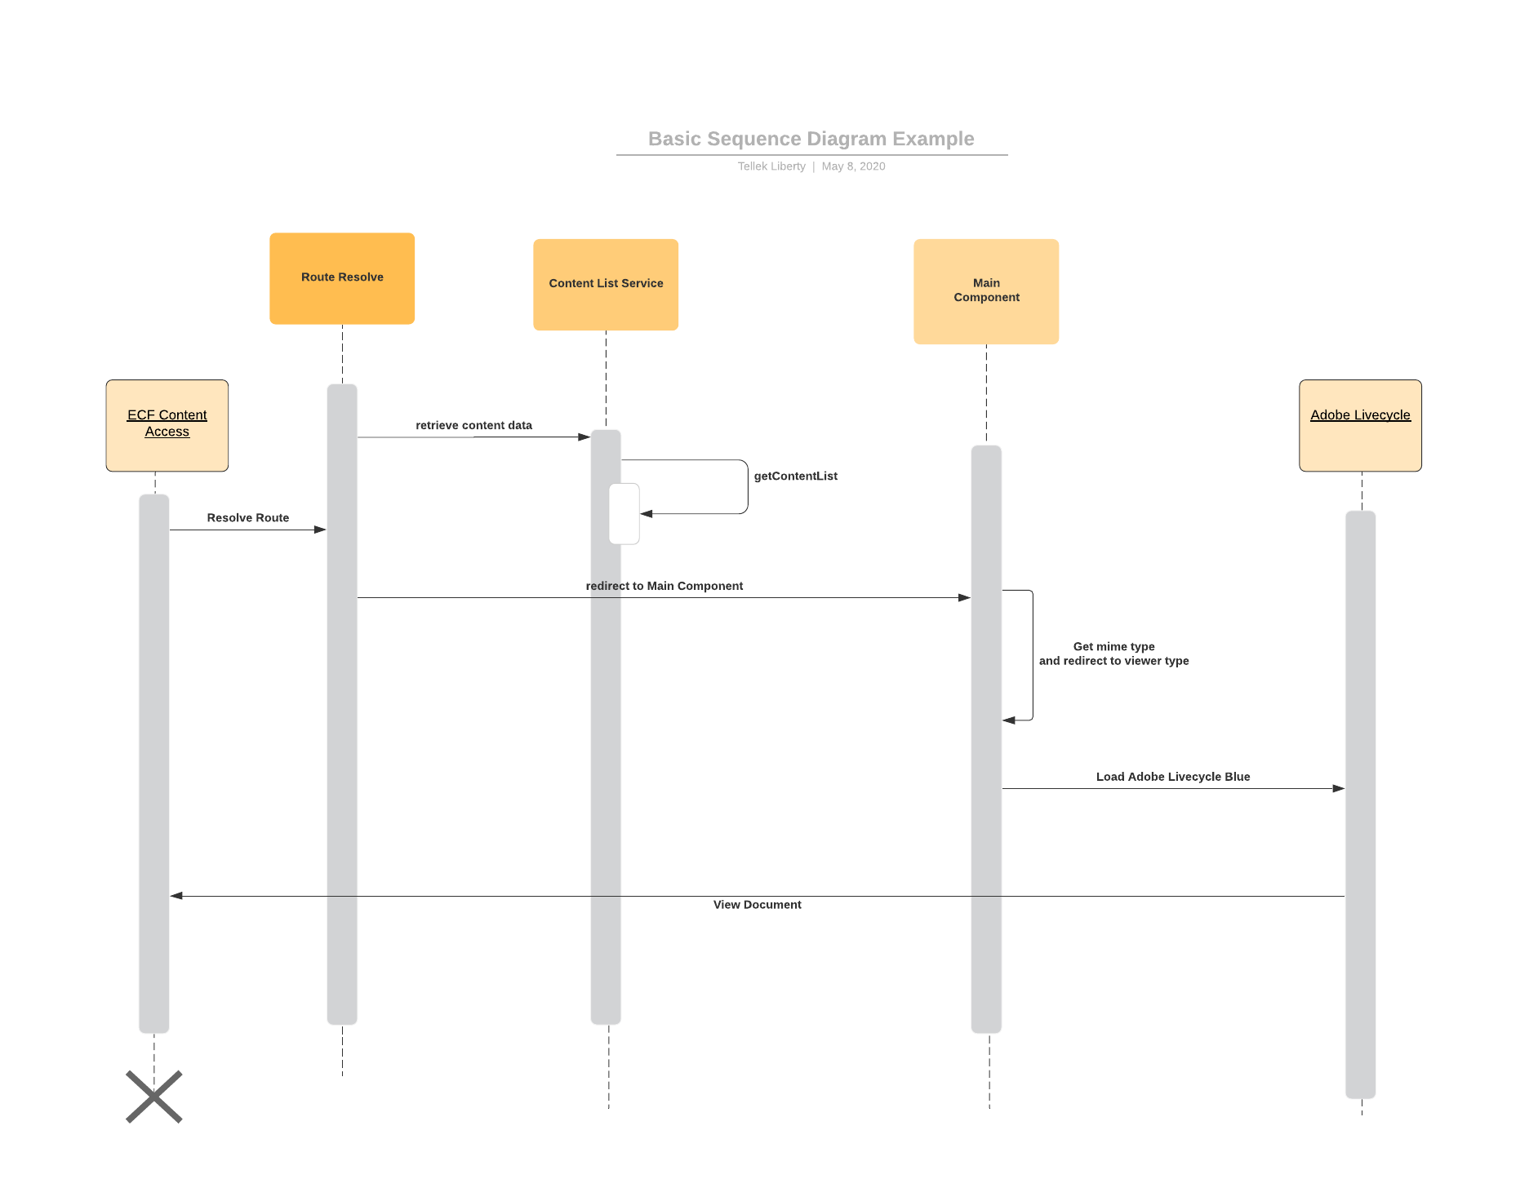
UI Flow for ECF Content Access

Slide 5
Coding and development With ECF Shared Library
What’s currently in the ECF Shared Library?
Peer Dependencies
ECF Shared Library Module and exporting artifacts to consumers
EcfLibModule – NgModule for ECF Shared Library
Public-api.ts file
DEMO
Handling communication between ECF Next and ECF Content Access – Storage Service
Encryption Service
Base Service
Configuration Service
Content List Service

Slide 6
Building ECF Shared Library
ECF Shared Build Process
Versioning – bump up the patch version. We need to determine when to do a major version increment.
Building ECF Shared Library
Execute “npm run build-ecf-shared”
Test ECF Shared Library
Change directory to dist folder and execute “npm pack”
Deploy to NPM
Change directory to dist folder and execute these commands – “npm login” and “npm publish”
Important NPM scripts in package.json for ECF Shared Library
To Perform all the above and Test in locally – “npm run publish-library-pack”
To Deploy to NPM Repository – “npm run publish-library-prod”

Slide 7
Testing ECF Shared in ECF Next
Passing information to ECF Content Access
DEMO

Slide 8
Testing ECF Shared in ECF Content Access
Passing information to ECF Content Access
DEMO

Slide 9
Debugging ECF Shared
DEMO

Slide 10
Updating README.md with your changes
What to put in the README markdown file
All documentation explaining Services, components, directives, pipes, .etc that will be used or exposed to ECF Next and ECF Content Access
Could include screenshot, if possible
Sample coding, where necessary
DEMO of README.md Contents
https://www.npmjs.com/package/@hennepin-mn-us/ecf-next-shared/v/5.0.13

Slide 11
Deploying ECF Shared to NPM
NPM LOGIN Command
NPM PUBLISH Command
NPM SITE
Hennepin’s temporary NPM Site - https://www.npmjs.com/~hennepin-m
Pricing - https://www.npmjs.com/products
Credentials – We need to change this
User Name: hennepin-m
Email: tellek.liberty@gmail.com
Password: Will email everyone
Credit Card Information for deploying – With free services, you can deploy a certain amount of times
See Building ECF Shared to Deploy to NPM

Slide 12
Installing and uninstalling ECF Shared Library
npm uninstall @hennepin-mn-us/ecf-next-shared
npm install --save @hennepin-mn-us/ecf-next-shared

Slide 13

Questions and Answers

Slide 14
Next ECF Shared Meeting Agenda
ECF Next and ECF Content Access Architecture
Sub Projects VS Angular Applications – Benefits and Disadvantages
Content List Drawer design Preparation
“Function Not Yet Developed!” Component could be a good recommendation for ECF Shared
Best Practices and Design Considerations for ECF Shared Library
Things to consider:
View Models (BIG TOPIC)
Keeping the balance between these principles
Release Reuse Equivalency Principle (The granule of release is the granule of reuse)
Common Closure Principle (Classes that change together, belong together)
Common Reuse Principle (Classes that aren’t reused together should not be grouped together)
Stable Abstraction Principles (Stable Packages should be abstract packages)
Extensibility (OCP Principle of the SOLID Principles)
Handling CSS Styles (Allow customization between ECF Next and ECF Content Access)
Routing vs Events (dealing with pitfalls when using routing between applications)
Customization to Business Logic – Headaches we had with PRIMENG, what to consider?

